Slide 1
Linear Regression Flashcard

Slide 2
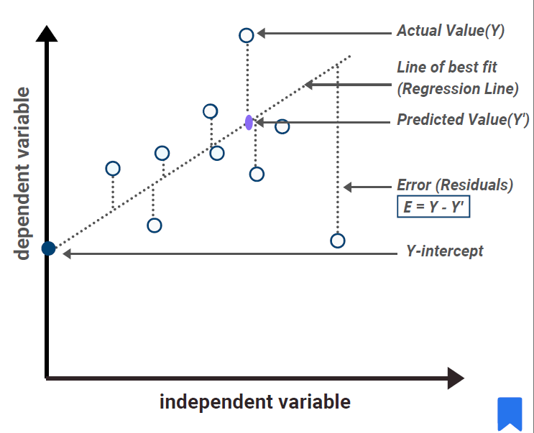
Question
What is linear regression?

Slide 3

What is linear regression?
Mathematically, the line can be expressed as
Linear regression is a statistical method used to model the relationship between a dependent variable and one or more independent variables
The goal of linear regression is to fit a straight line or hyperplane through the data points that best represents the relationship between the variables
y is the dependent variable
x is the independent variable
​β0 is the intercept
β1 is the slope of the line, which represents how much y changes for a one-unit increase in x,
ϵ represents the error term

Slide 4
Linear Regression - Training
During training, linear regression finds the values of β (coefficients) that minimize the error between predicted and actual values.
This is typically achieved by minimizing the sum of squared errors, which gives us the best-fitting line or hyperplane through the data points in the feature space.
Once trained, the model can then be used to make predictions on new, unseen data
After the model is fitted, we can make predictions by plugging in new values for X1,X2,…,Xn​ into the learned linear equation.
The model outputs a single predicted value for the target variable based on the weighted sum of predictors and the intercept.

Slide 5
Linear Regression
Limitations
Interpretation
Linear regression works well when the assumptions of linearity, independence, homoscedasticity, and lack of multi-collinearity hold.
It’s best suited for cases where the relationships between predictors and the target are linear.
For nonlinear relationships, we may either transform variables or consider other models.
Additionally, since linear regression is sensitive to outliers, robust preprocessing can help ensure stable and reliable predictions
One of the advantages of linear regression for prediction is that each coefficient βi tells us how much the target variable is expected to change with a one-unit increase in the corresponding predictor, holding other variables constant.
This makes the predictions not only accurate but also interpretable, which can be particularly useful in applications like finance, healthcare, or any domain where understanding the impact of each predictor is valuable

Slide 6
Question
What are the assumptions underlying linear regression?

Slide 7
What are the assumptions underlying linear regression?
Linearity: There exists a linear relationship between the independent variable and the dependent variable
Independence of errors: The errors should be independent of each other (No auto-correlation)
Constant variance: The error term has a constant variance (homoscedasticity) across all levels of independent variable
Normality: The error tem is normally distributed
No perfect multi-collinearity: There is little or no multi-correlation in the observations

Slide 8
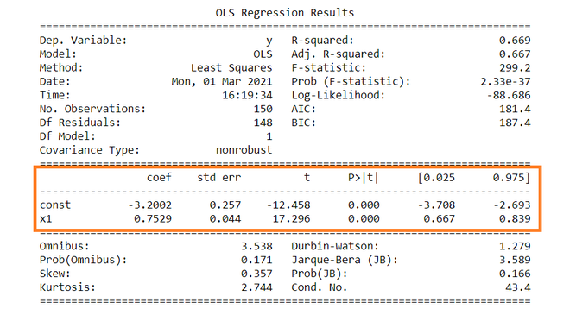
Question
How do you interpret the coefficients of a linear regression model?

Slide 9
Coefficient estimates
Interpretation of Sign:
The sign of a coefficient (positive or negative) tells us the direction of the relationship.
A positive coefficient indicates that as the predictor increases, the target variable is expected to increase, while a negative coefficient implies an inverse relationship.
For instance, in a model predicting house prices, a positive coefficient for square footage suggests that larger houses tend to have higher prices, all else being equal
The coefficient estimates denotes the change in the mean of outcome (dependent) variable for a unit change in the predictor (independent) variable assuming all other predictors are constant
Interpretation of Slope:
For example, if a coefficient for a predictor X1​ is 2.5, then, all else being equal, a one-unit increase in X1​ would lead to an increase of 2.5 units in the target variable Y
The intercept represents the expected value of the target variable when all predictors are zero.

Slide 10
Question
What is the role of intercept in a linear regression model?

Slide 11
Intercept
The intercept essentially shifts the regression line up or down to minimize the residuals.
It ensures that the line of best fit passes as close to the center of the data as possible, allowing the model to minimize the overall prediction error
The intercept represents the expected value of the dependent variable when all independent variables are zero
Interpretation:
For instance, in a model predicting salary based on years of experience, the intercept might represent the base salary someone could expect with zero years of experience, which is often a reasonable interpretation
Having said that, intercepts are meaningful when zero is within the plausible range of the predictors

Slide 12
Question
What is the method of least squares in the context of linear?

Slide 13
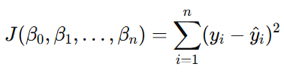
Least Squares
Squared Errors:
Squaring the residuals ensures all residuals are positive, which avoids positive and negative errors canceling each other out.
It penalizes larger errors more heavily, encouraging the model to fit points with large deviations more closely
The method of least squares is used to estimate the parameters that define the best splitting line in the data
In linear regression, we’re looking to draw a hyperplane that best represents the relationship between the independent variables and the dependent variable
The method of least squares is an optimization approach that finds this hyperplane by minimizing the sum of the squared differences between the actual values and the predicted values

Slide 14
Question
How do you assess the goodness of fit of a linear regression model?

Slide 15
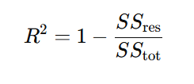
Goodness of fit
Goodness of fit can be assessed by R-squared (Coefficient of determination). R-squared score denotes proportion of variance of the target variable that can be explained by the independent variables.
R-squared values range between 0 to 1. The values closer to 1 suggests a better fit.
For example, R-squared value of 0.85 indicates that 85% of variance in target variables are modeled by the independent variables
However, R-squared values needs to be interpreted cautiously as multiple predictors can inflate the r-squared values
SSres​ is the sum of squared residuals (the differences between observed and predicted values).
SStot is the total sum of squares (the differences between observed values and the mean of the dependent variable).

Slide 16
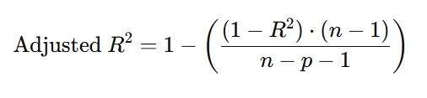
Adjusted R-squared
Adjusted R-squared adjusts the standard R-squared for the number of independent variables in the model
While R-squared can only increase or stay the same when more predictors are added.
Adjusted R-squared can decrease if the added predictors do not significantly improve the model
The significance of adjusted R-squared lies in its ability to provide a more accurate measure of how well the model generalizes to new data.
By incorporating a penalty for the number of predictors, adjusted R-squared discourages overfitting—a scenario where the model performs well on training data but poorly on unseen data.
This makes it a valuable tool for model evaluation and comparison
R^2 is the standard R-squared value,
n is the number of observations, and
p is the number of independent variables in the model
Limitations:
While adjusted R-squared is more informative than R-squared, it is not the only criterion for model evaluation. It’s important to also consider other metrics, such as
AIC (Akaike Information Criterion)
BIC (Bayesian Information Criterion)

Slide 17
Question
What is multicollinearity, and why is it a problem in linear regression?

Slide 18
Multi-collinearity
Reduced Interpretability: With highly correlated predictors, it becomes challenging to determine the individual effect of each predictor on the dependent variable.
Inflated Standard Errors: Multi-collinearity can inflate the standard errors of the coefficients, leading to wider confidence intervals and making it harder to detect statistically significant predictor
Multi-collinearity refers to a situation in linear regression where two or more independent variables are highly correlated with each other.
For instance, if you have two variables, say "square footage" and "number of rooms" in a housing price prediction model, they may be correlated, as larger houses typically have more rooms
Unstable Coefficients: When multi-collinearity is present, the estimated coefficients of the correlated variables can become very sensitive to small changes in the data. This means that slight variations in the dataset can result in large fluctuations in the coefficient estimates, making them unreliable and difficult to interpret.

Slide 19
Multi-collinearity
Detection:
Correlation Matrix: Examining the correlation matrix of the independent variables can help identify pairs of variables that are highly correlate.
Variance Inflation Factor (VIF):
The VIF quantifies how much the variance of a coefficient is inflated due to multi-collinearity.
A VIF value greater than 10 is often considered indicative of significant multi-collinearity.
Ways to handle Multi-collinearity:
Removing Variables: One of the simplest solutions is to remove one of the correlated predictors from the model. This helps to clarify the relationships without losing too much information.
Combining Variables: In some cases, creating a composite variable can reduce multi-collinearity while retaining useful information.
Regularization Techniques: Techniques such as Ridge Regression or Lasso can help mitigate the issues of multi-collinearity by adding a penalty to the size of the coefficients, thus stabilizing the estimates

Slide 20
Question
How do you conduct hypothesis testing in Linear regression?

Slide 21
Coefficients – Hypothesis Testing
Null Hypothesis (H_0): The coefficient is 0 indicating there is significant effect of the independent variable on the dependent variable
Alternate Hypotheses (H_a): The coeffiecient is non-zero indicating a relationship between independent and the dependent variable.
Fit a model
T-Statistic : Coefficient / Standard error of coefficient
Calculate p-value for each coefficient
If p-value is less than the significance level, it indicates there is a statistically significant effect of the independent variable on the dependent variable

Slide 22
Question
What are residuals? Why are they important in Linear regression?

Slide 23

Residuals
Several key assumptions must hold true, such as
Linearity
Independence
homoscedasticity (constant variance)
normality of residuals.
By examining residuals through plots, such as residuals versus fitted values or a histogram of residuals, we can visually assess whether these assumptions are satisfied.
Residuals are the differences between the observed values of the dependent variable and the predicted values obtained from the linear regression model.
where y_i is the actual observed value and y^_i​ is the predicted value. Essentially, residuals capture the error in our predictions

Slide 24
Question
Explain the concept of homoscedasticity

Slide 25
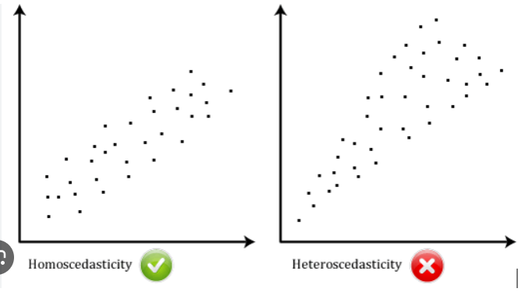
Homoscedasticity
In contrast, if the residuals exhibit non-constant variance—known as heteroscedasticity—it can lead to inefficiencies in the model and biased estimates of the standard errors, which in turn affects hypothesis testing
Homoscedasticity refers to the assumption that the variance of the residuals is constant across all levels of the independent variable(s).
This means the spread or variability of the errors does not change as the value of the independent variables changes
When this assumption is met, it suggests that the model’s predictions are equally reliable across the range of data.
Linear regression relies on the premise that the errors are evenly distributed. If this assumption holds true, it helps ensure that statistical tests (like t-tests and F-tests) related to the coefficients are valid, making our inferences about the relationship between variables more reliable

Slide 26
Homoscedasticity
Heteroscedasticity can lead to:
Inconsistent estimates
Biased standard errors
Incorrect inference of p-value
Handling:
Transformation of variables like log, square root
Detection:
We can visually assess homoscedasticity by plotting the residuals against the predicted values or one of the independent variables.
In a well-behaved homoscedastic scenario, the residuals should display a random scatter around zero, forming a horizontal band.
If we observe patterns such as a funnel shape or systematic increase/decrease in the spread of residuals, this indicates heteroscedasticity

Slide 27
Question
Explain the significance of the p-values in the regression analysis

Slide 28
Significance of p-values in Regression Analysis
P-value indicates the probability of observing the estimated coefficient of the predictor variable, as extreme or more extreme given the null hypothesis is true
Null hypothesis here states that the coefficient is zero and there is no relationship between the predictor variable and the target variable
p-values are used to evaluate the individual significance of each predictor. This allows us to determine which variables are meaningful contributors to the model
Considerations:
When we test multiple predictors in a single model, we increase the risk of Type I errors (false positives). This means we might incorrectly conclude that a variable is significant when it is not
they don’t provide information about the magnitude or practical significance of the effect.
Small p-value does not imply causation

Slide 29
Question
How do you interpret standard error in regression model?

Slide 30
Standard Error
Standard Error in a regression model measures the variability or dispersion of observed values around the predicted values
It tells us how much the estimated coefficient for a predictor variable is expected to vary across different samples from the same population.
Standard error is a measure of the precision of that coefficient estimate
A smaller standard error indicates that the coefficient is estimated with greater precision, whereas a larger standard error suggests more variability in the estimate.
Typically, a 95% confidence interval can be calculated by taking the coefficient estimate and adding and subtracting two times the standard error. This interval provides a range of values within which we can expect the true coefficient to lie with a certain level of confidence.
they don’t provide information about the magnitude or practical significance of the effect.
Small p-value does not imply causation

Slide 31
Question
What is the F-test in the context of Linear Regression?

Slide 32
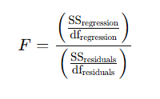
F-test
Interpretation
A larger F-statistic indicates that a greater proportion of the variance in the dependent variable is explained by the model relative to the variance unexplained
A large F-statistic and a small p-value (Prob (F-statistic)) indicate that the model is statistically significant, meaning that at least one of the independent variables is significantly related to the dependent variable
F-statistic tests the significance of that explanatory power by evaluating if the observed R-squared is due to chance
The F-test is used to assess whether our model, as a whole, is statistically significant.
Specifically, it tests the null hypothesis that all the regression coefficients, except for the intercept, are equal to zero.
In other words, it examines whether the independent variables in the model collectively have a meaningful relationship with the dependent variable.
How?
Explained Variance: This is the variability in the dependent variable that can be explained by the independent variables in the model
Unexplained Variance: This is the variability that remains in the dependent variable even after accounting for the independent variables, represented by the residuals

Slide 33
Question
How can you check for the normality of residuals?

Slide 34
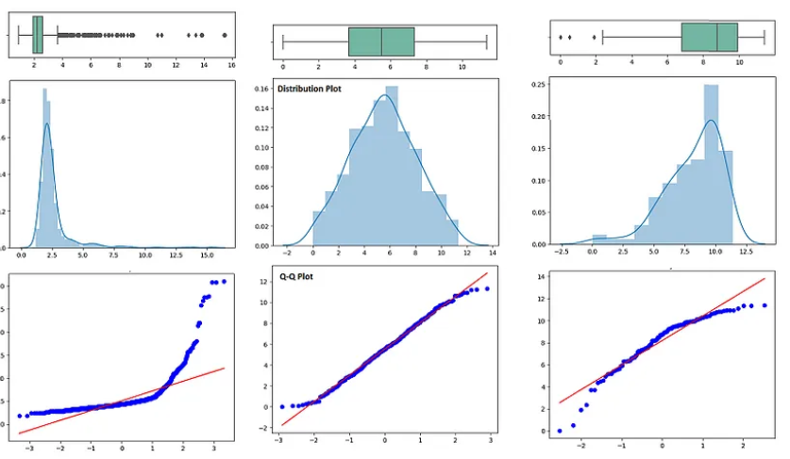
Normality of residuals
Normality is the assumption that the underlying residuals are normally distributed
Methods:
Histogram (bell shaped curve)
QQ-plot (points closely follow 45 degree line)
Shapiro Wilk test : the null hypothesis that the data is drawn from a normal distribution
KS-test: a small p-value would indicate that the residuals deviate significantly from normality
Both Shapiro Wilk test and KS test are sensitive to large sample sizes

Slide 35
Question
Can Linear regression be used for classification problems?

Slide 36
Classification with Linear Regression
Yes, linear regression can technically be used for classification problems, although it's not generally recommended for most classification tasks.
In linear regression, we’re typically predicting a continuous outcome, but for a binary classification problem, we might map class labels to binary values—0 for one class and 1 for the other.
By fitting a linear regression model, we’ll get a continuous output. We can interpret this output as a probability by setting a threshold, often 0.5, to determine the predicted class. For instance, if the predicted value is above 0.5, we might classify it as class 1; if it’s below 0.5, we classify it as class 0
Limitations
Range of Predicted Values: Linear regression doesn’t constrain predictions to the [0,1] range, so it can output values far outside this interval. For instance, we might see values like -0.5 or 1.3.
Lack of Optimal Decision Boundaries: In classification, we often want a clear separation between classes. Linear regression minimizes the mean squared error, focusing on the best fit for continuous outcomes, not discrete ones

Slide 37
Question
How do you select variables for Linear regression model

Slide 38
Variable Selection with Linear Regression
Business knowledge and Domain understanding
Exploratory Data Analysis
Correlation matrix
Variance Inflation Factor (VIF)
P-values
Backward elimination, forward selection, stepwise selection
Regularization techniques

Slide 39
Question
For a linear regression model, How do you handle non-linear relationships in your data?

Slide 40
Non-Linear relationships
Polynomial features: For example, in a dataset where the target variable has a parabolic relationship with the predictor, adding x^2 as a feature can help capture that curvature without requiring a more complex model
Logarithmic/exponential transformation: For instance, taking the logarithm of a positively skewed predictor variable can linearize a relationship and stabilize variance, which improves the model fit
Interaction features
Binning/Splines: allow me to fit piecewise polynomials that can model different sections of the predictor at different rates. This method is very flexible, enabling the model to capture local changes in slope without affecting the global relationship as a polynomial feature might

Slide 41
Question
What is the VIF (Variance Inflation Factor), and how is it used?

Slide 42

Variance Inflation Factor
Interpretation:
A VIF of 1 indicates no correlation with other variables, suggesting no multi-collinearity.
A VIF between 1 and 5 suggests moderate correlation
A VIF above 5 often signals potentially problematic multi-collinearity
Diagnostics with VIF:
Model stability: High VIFs can lead to large standard errors for the coefficients, meaning that small changes in the data could cause large swings in estimated coefficients
Identifying redundant variables
Guiding variable selection
The Variance Inflation Factor, or VIF, is a metric used to detect multi-collinearity in a linear regression model.
Multi-collinearity occurs when two or more predictor variables in the model are highly correlated, which can cause instability in the coefficient estimates and make the model less interpretable and reliable
For a given predictor, the VIF is calculated by regressing that predictor on all other predictors in the model. The resulting R^2 value from this auxiliary regression shows how well the predictor is explained by the others.

Slide 43
Question
How do you deploy the model in production

Slide 44
Model deployment in production
Containerization: ensure the model runs consistently across different environments, I typically containerize it using Docker. By including the model, its dependencies, and pre-processing steps in a Docker image, I create a standardized setup that can be deployed to cloud platforms like AWS
In my experience, deploying a linear regression model in a production environment goes beyond just model performance; it’s about creating a solution that’s scalable, reliable, and easily accessible for business applications. Here’s how I approach it.
I start by setting up an end-to-end pipeline that includes all necessary pre-processing steps, such as data cleaning, feature engineering, and scaling.
Using tools like Scikit-learn’s Pipeline module ensures these steps are consistently applied to any new data coming into the model

Slide 45
Question
What are some challenges of Linear regression when dealing with high dimensional data?

Slide 46
Challenges with High-Dimensional data
Multi-Collinearity: In high-dimensional data, it’s common to encounter multi-collinearity, where two or more predictors are highly correlated. This can lead to unstable coefficient estimates and inflated standard errors, making it difficult to interpret the significance of predictors.
Data Sparsity: High-dimensional datasets, especially those common in text or categorical data, often exhibit sparsity, meaning many features contain zero or missing values. This can skew the results and complicate the model fitting process
Overfitting
Multi-Collinearity
Interpretability
Computational Complexity
Data Sparsity
Violation of Assumptions
Overfitting: One of the most significant challenges in high-dimensional datasets is overfitting. When you have more features than observations, a linear regression model can easily learn the noise in the training data rather than the underlying patterns. This results in poor generalization to new data. To combat this, I often employ regularization techniques like Lasso or Ridge regression, which add penalties to the loss function to constrain the model complexity and help prevent overfitting.

